Slide 1

PC Games Score Prediction
Data Science project by:
Lior Fridman
Saar Nagary

Slide 2
INTRODUCTION
PRESENTATION
ANALYSIS
CONCLUSION
describing the topic of the project and assets
Presenting our project in general
Analyzing the final results
Summerizing the final conclusions

Slide 3

STEAM
Steam is a video game digital distribution service and storefront by Valve. Steam was launched as a software client in September 2003 as a way for Valve to provide automatic updates for their games, and expanded to distributing and offering third-party game publishers' titles in late 2005.
Steam offers various features, like digital rights management (DRM), game server matchmaking and anti-cheat measures, and social networking and game streaming services. It provides the user with automatic game updating, saved game cloud synchronization, and community features such as friends messaging, in-game chat and a community market.
The Steam platform is the largest digital distribution platform for PC gaming, estimated around 75% of the market share in 2013 according to IHS Screen Digest .By 2017, users purchasing games through Steam totaled approximately US$4.3 billion, representing at least 18% of global PC game sales according to Steam Spy.
By 2019, the service had over 34,000 games with over 95 million monthly active users.

Slide 4

METACRITIC
Metacritic is a website that aggregates reviews of films, TV shows, music albums, video games and formerly, books. For each product, the scores from each review are averaged (a weighted average). It is regarded as the foremost online review aggregation site for the video game industry.
Metacritic's scoring converts each review into a percentage, either mathematically from the mark given, or what the site decides subjectively from a qualitative review. Before being averaged, the scores are weighted according to the critic's fame, stature, and volume of reviews. The website won two Webby Awards for excellence as an aggregation website.
a METASCORE is a weighted average of reviews from top critics and publications for a given movie, TV show, video game, or album.

Slide 5
What are we trying to achieve?
We will try to figure out if we could predict the final users score in ‘Metacritic’ that is presented in ‘Steam’
By using a list of games from Steam with all relevant information
By using a list of criticized games from Metacritic with all grades
By merging the two data frames and analyzing the results
Finally we will use Linear regresion to predict the users game score

Slide 6
01
DATA ACQUSITION
Using Selenium , time , bs4 , pandas , Req

Slide 7

Crawling 01
We tried to use normal req for getting the final HTML, but encountered by an obsticle. In Steam’s search page there is no “Next” button or page number. In order to get the final HTML we used “Selenium” and created a loop that scrolles down every second and gets another 50 games in the list. We initiated the scrolling times to 100 in order to get 4950 games in one HTML code.

Slide 8

Crawling 02
We used bs4 and kept the final html from Selenium in a soup parameter. We extracted all the necessary classes from the soup and kept all the data in lists. We used another loop to dive into each and every hyperlink on Steam, and gathered more information that was not seen on the main page. (such as storage capacity, game labels, genres and more.

Slide 9

Crawling 03
Finally we gathered enough information about our games and created a primary data frame.
In it we chose 20 columns and used our data to fill them. Our data frame contained 103,970 cells.
We saved the CSV file as rowDF.csv.

Slide 10
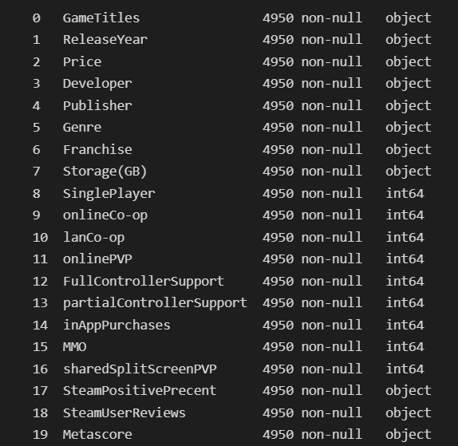
THE CLEANED DATA FRAME CONTAINED
GAME’S NAME
YEAR OF RELEASE
GAME’S PRICE
GAME’S DEVELOPER
GAME’S PUBLISHER
GAME’S PRIMARY GENRE
GAME’S FRANCHISE
CAPACITY OF STORAGE
IS SINGLE PLAYER
IS CONTAINING ONLINE CO-OP

Slide 11
THE CLEANED DATA FRAME CONTAINED
IS CONTAINING LAN CO-OP
IS CONTAINING ONLINE PVP
IS SUPPORTING FULL CONTROLLER
IS SUPPORTING PARTIAL CONTROLLER
IS HAVING IN-APP PURCHASES
IS MMO
IS SHARED SCREEN COMPITABLE
PRECENTAGE OF POSITIVE USER REVIEWS
NUMBER OF USERS REVIEWS
METACRITIC SCORE ON STEAM

Slide 12

02
DATA HANDLING
Conversion, Purifying and Improvement for the information

Slide 13
IN THIS PHASE WE USED…
Converting some columns from ‘object’ to ‘string’ or ‘int’
Removing unwanted phrases and marks from the HTML code
Converting ‘Storage’ column to unified size of GB
Removing the day and month, remaining only with year in ‘RealeaseYear’
Isolating a primary genre for each game
Setting ‘Free to play’ games to cost 0 and picking the priced value if got any

Slide 14
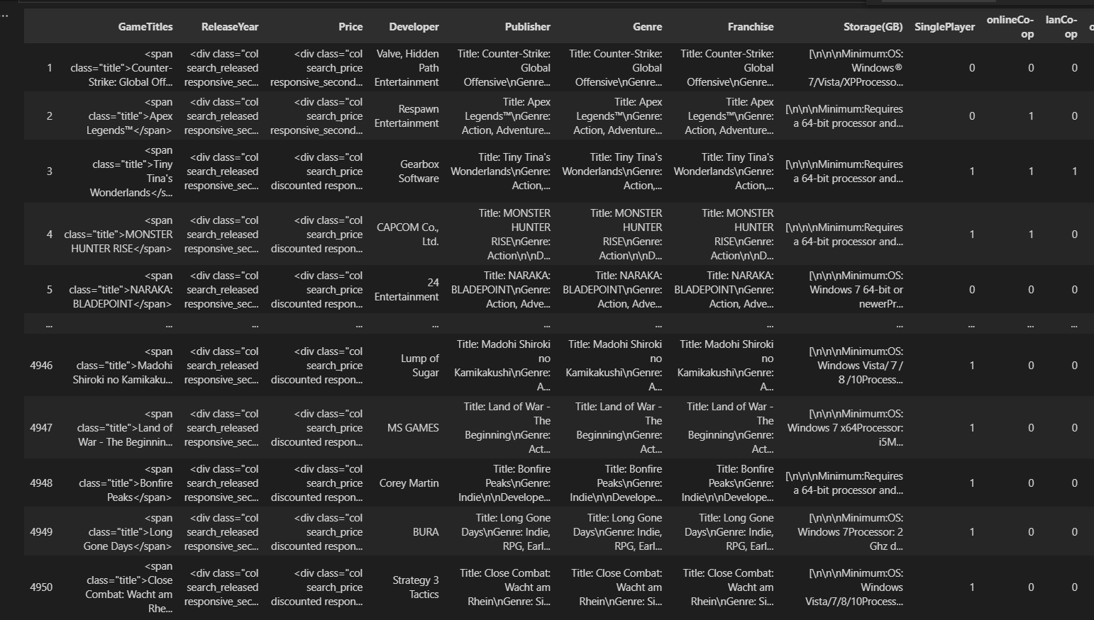
OUR DATA FRAME BEFORE DATA HANDLING

Slide 15
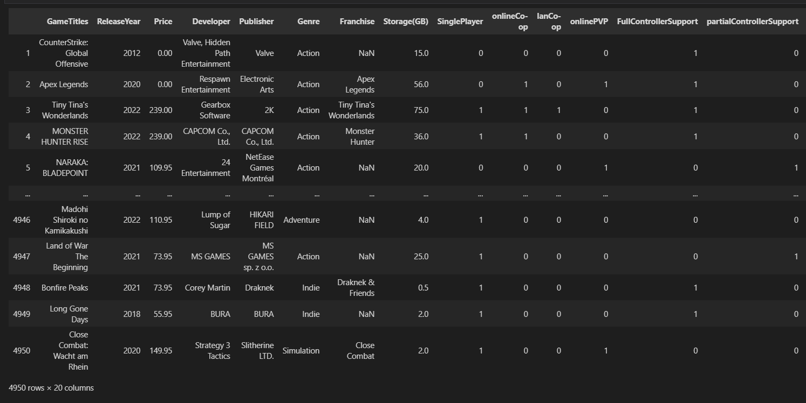
OUR DATA FRAME AFTER DATA HANDLING

Slide 16
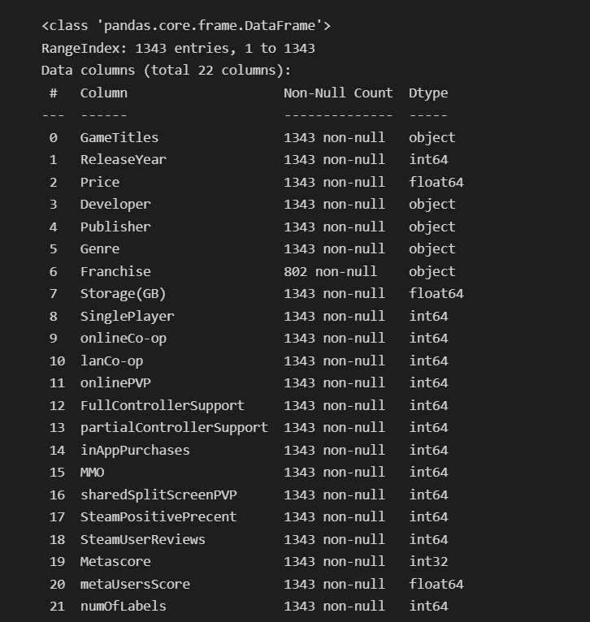
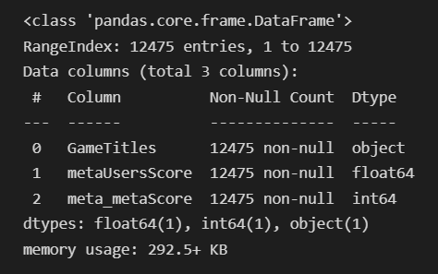
MERGING TWO DATA FRAMES
We used Selenium again in order to extract data from ‘Metacritic’, runnig and inserting to lists all games from 1 to 125 pages – total of 12,475 games to merge with our primary clean data frame.

Slide 17
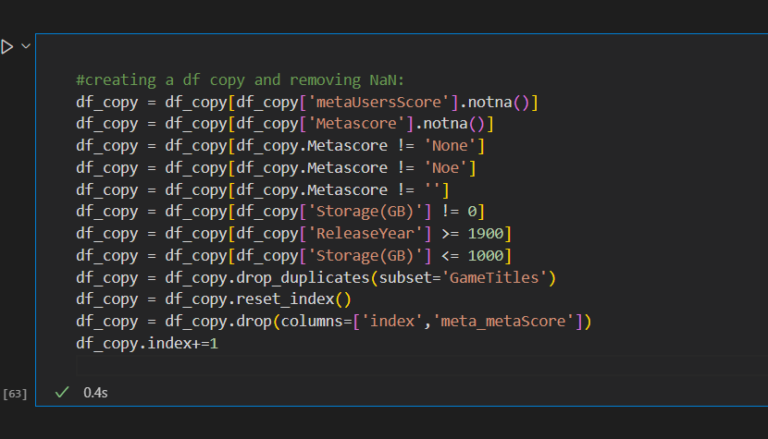
DROPING UNWANTED VALUES
We droped all NaN / null values, all exagurated values (like storage above 1000 GB or 0 GB, and ReleaseYear less then 1900) ,droped all duplicates and unwanted columns.

Slide 18

03
EDA AND VISUALIZATION
Droping unwanted data and creating graphs

Slide 19
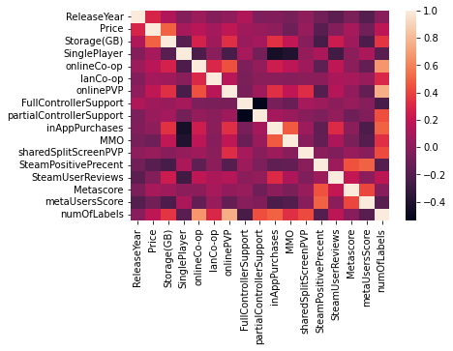
READING THE HEATMAP
We exported a SNS heatmap, and used ‘pearson’ corrolation to find the most corrolated columns.
We found that ‘SteamPositivePercent’ and ‘metaUsersScore’ has good corrolation, and also ‘Metascore’ and ‘metaUsersScore’, and ‘Price’ and ‘Storage(GB)’ too.
Then we exported graphs accordingly.

Slide 20
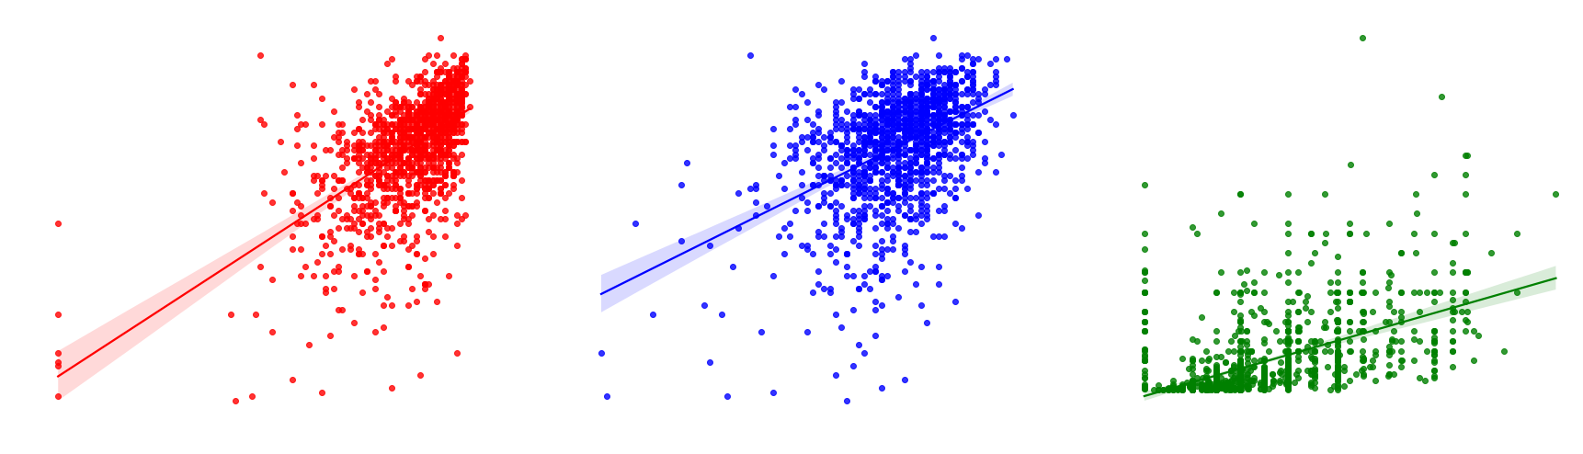
READING THE GRAPHS 01
Scatterplots

Slide 21
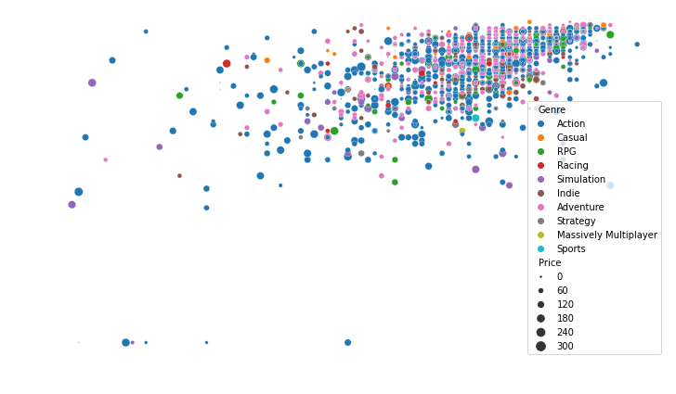
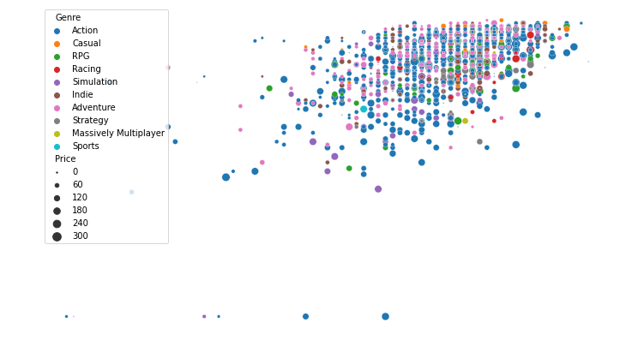
READING THE GRAPHS 02

Slide 22
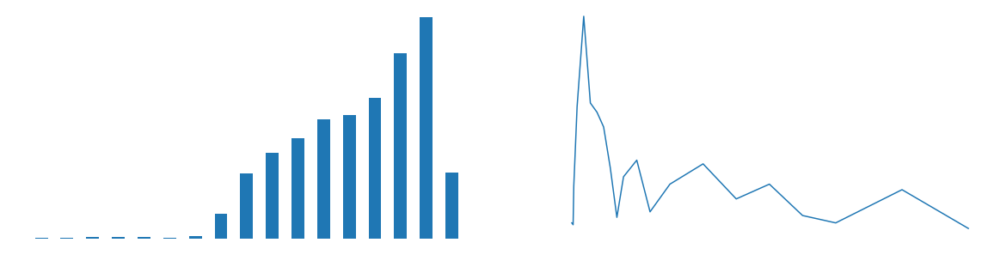
READING THE GRAPHS 03
ReleaseYear Storage(GB)

Slide 23
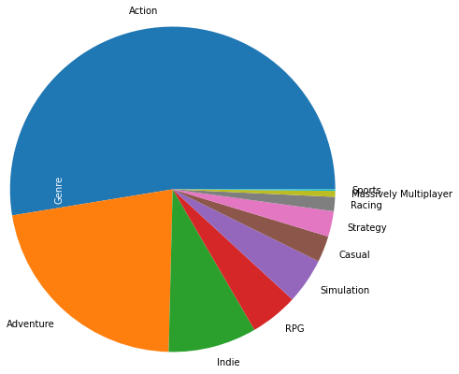
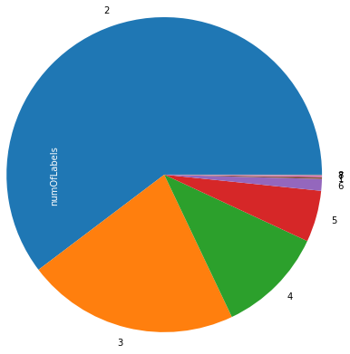
READING THE GRAPHS 04
Genres Number of labels

Slide 24
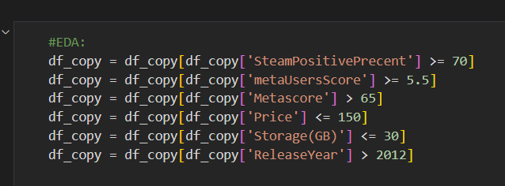
EDA AND GENERATING GRAPHS AGAIN
After getting the results of visualization we found outliers and anomalous values. We got rid of them and generated all graphs again.

Slide 25
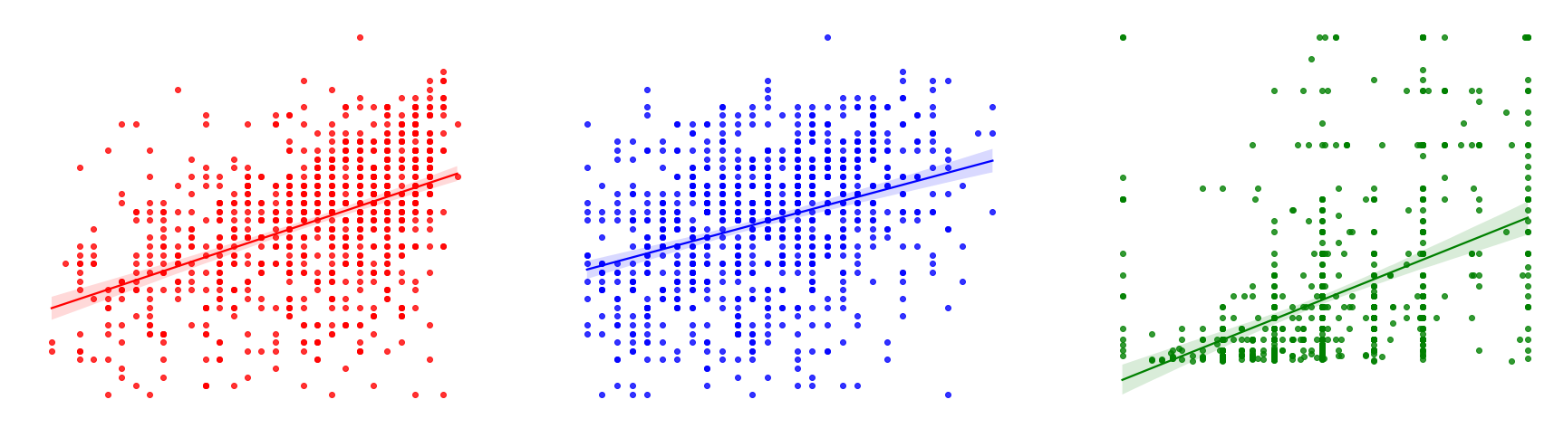
THE NEW SCATTERPOLTS
We can see that the results may be clean of many outliers but by seeing that the dots are all scattered, we can assume there is no real tendency.

Slide 26

04
LINEAR REGRESSION AND PREDICTION

Slide 27
THE PREDICTION RESULTS 01
01
03
We used linear regression to achieve a prediction
We kept the final result as the main final data frame
02
We saw that the value is worse then the time we didn’t use EDA

Slide 28
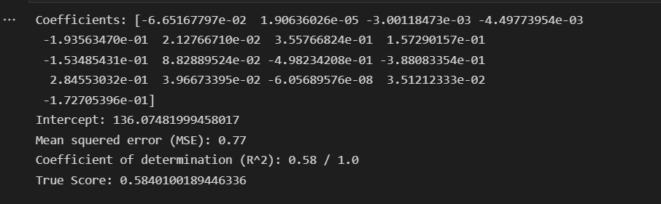
THE PREDICTION RESULTS 02
We dropped more columns that stored string typed data – such as ‘GameTitles’,’ Publisher’, ‘Developer’ and ‘Franchise’.
We converted ‘Genre’ column numbers using LableEncoder.
We used linear regression on ‘metaUsersScore’, creating x and y train, and x and y test parameters.
After the EDA, our final score was about 0.28.
Here our final results after the predictions without EDA.

Slide 29

FINAL CONCLUSIONS
We might have needed more data and more columns to achieve a better prediction.
We might have needed more gaming websites for more rows in the final data frame and more information for the linear regression.
We might have needed to use user’s reviews, label encode all the positive and negetive words to improve predicction.
Using EDA did not help us, and even made our result worse - That could be because of underfitting.

Slide 30
OUR TEAM
LIOR FRIDMAN, 25
SAAR NAGARY, 24
Data Science student
Data Science student

Slide 31

THANKS!

